Slide 1
Presentation To The
RI Special Legislative Commission To Study Housing Affordability
Frank O’Brien
Vice President & General Counsel
January 15, 2026

Slide 2
RIJRA Basics
Rhode Island Joint Reinsurance Association (RIJRA) – the “RI FAIR Plan”
Established pursuant to statute (27-33-11), governed by regulation (230 RICR 20-05-11), and its governing documents.
35 states have residual property insurance markets: Fair Plans, Beach Plans, Wind Plans, and Citizens Plans. Some states have more than one plan.
The purpose of RIJRA is to:
  make Basic Property Insurance available to qualified applicants who have been unable to secure such insurance in the normal market;
  encourage improvement of properties located in urban areas; and
  further community development.

Slide 3
RIJRA Basics Cont’d
All licensed insurers writing property insurance in RI are required to participate.
Not a state agency. Essentially a partnership where profits and losses are shared based on market share.
Overseen by RIDBR and an 18-member Governing Committee comprised of 10 insurers, 6 public members, and 2 agents.
Managed by MPIUA (Mass FAIR Plan) since 1974.
  135 employees with a full compliment of underwriting, claims, legal services. Everything but a marketing department.

Slide 4
RIJRA Basics Cont’d
RIJRA provides a range of HO and DP policies akin to what is found in the voluntary market.
  The maximum coverage limit for Owners Forms (HO 2,3,5 & 8) offered at the RIJRA is $1,250,000 effective April 1, 2024.
  Condo and renters coverage is offered as is a unique stand-alone lead policy. We also have a very small number of commercial policies.
RIJRA does not offer flood insurance, not does it require a flood policy to be purchased to qualify for FAIR Plan coverage.
The RIJRA’s market share as of December 2024 is 3.99%.

Slide 5
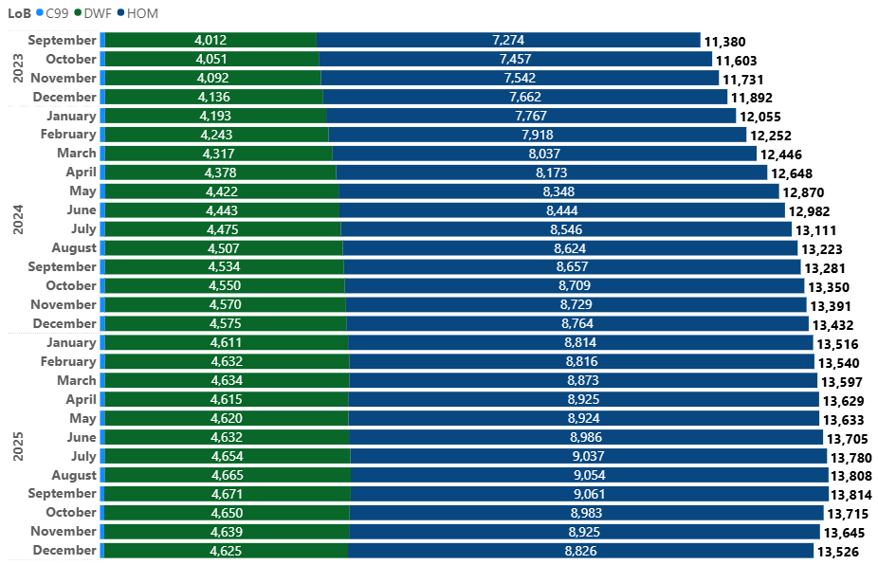
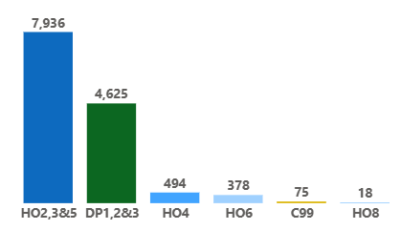
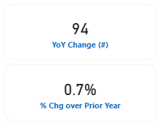
In-Force Policy Statistics @ 12.31.2025

Slide 6
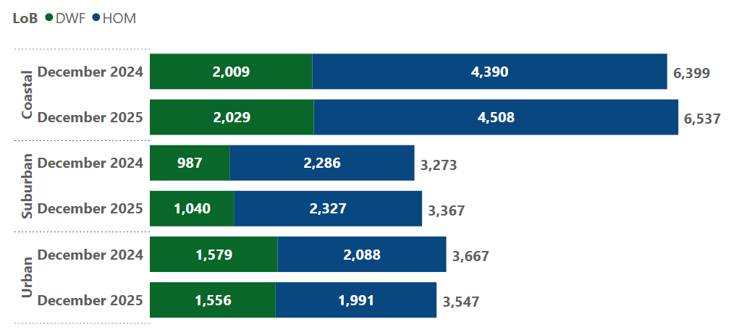
Growth by Geographic Area
YoY Growth
Coastal: 138 policies or 2.15%
Suburban: 94 policies or 2.85%
Urban: -120 policies or
-3.27%

Slide 7
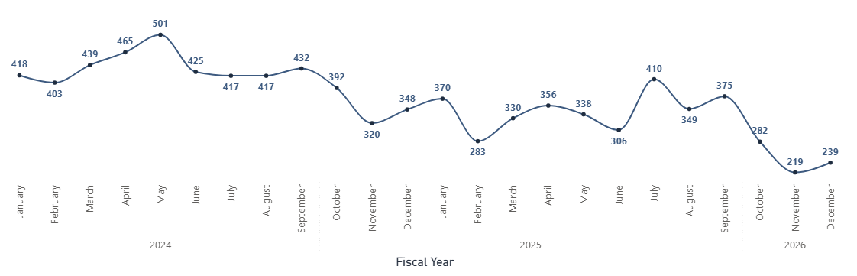
Monthly New Business Applications – 24 Month View

Slide 8
Economic Impact of RIJRA
Provides stable insurance availability statewide.
Allows Real Estate Market to function by allowing people to meet insurance requirements of mortgagees.
Properties are required to be properly maintained promoting community development.

Slide 9
Who May Apply & Eligible Property
Who
Any person or legal entity that has an insurable interest in the property
Eligibility
Real or Tangible Personal Property
Fixed Location in Rhode Island
Insurable Interest Must exist
Insurable Condition

Slide 10
How RIJRA Differs from Voluntary Insurers
Similarities
Accepts applications
Underwrites all risks
Issues policies
Purchases Reinsurance
Adjusts and pays losses
Inspects all properties
Maintains all appropriate records
Performs all necessary administrative functions found in voluntary insurance operations
Differences
Should only be used if coverage is not available in the voluntary market
Producer has no binding authority
Producer represents the insured in transacting business with RIJRA
No Marketing Department
Selectivity –Underwriting based on policy form eligibility, FAIR Plan Underwriting Standards and condition of property.

